Slide 1



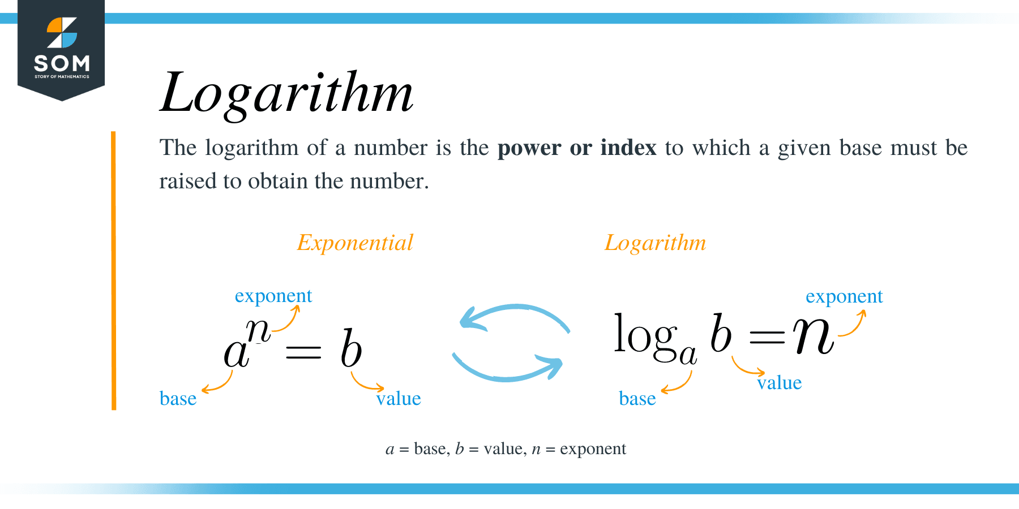

Obligations by Role: Developer vs. Deployer
Establish AI QMS: policies, roles, training, documentation.
Data governance: provenance, consent/rights, quality, representativeness.
Model risk management: testing (safety, security, bias, robustness), adversarial/red‑team exercises.
Technical documentation: model cards, data sheets, evaluation reports, usage constraints.
High‑risk/GPAI specifics: EU conformity approach, GPAI transparency/diligence; US EO reporting for powerful models; CN algorithm filing/security review.
Use‑case risk assessment: context, impact on individuals/rights, safety dependencies.
Human oversight design: competence, escalation/override, fallback procedures.
Operational controls: logging, monitoring, incident reporting, rollback plans.
Transparency to end‑users: notices, labeling (e.g., synthetic content), records retention.
Sectoral compliance: employment, credit, health, safety; public sector IA (OMB/UK, where applicable).

